Slide 1
HUBzero Platform Features Demo of Capabilities for the TRADES Program Oct. 12, 2016 Derrick Kearney hubzero.org

Slide 2
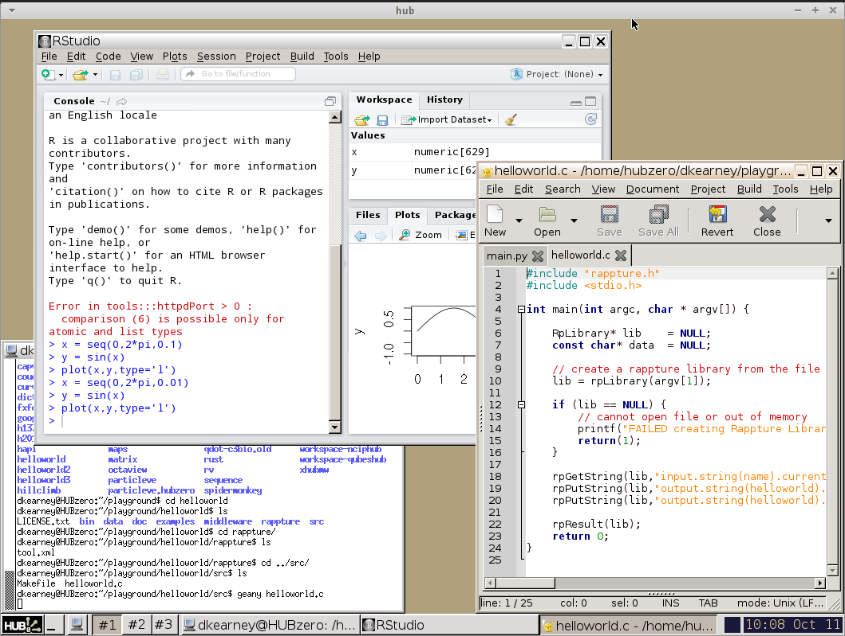
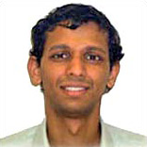
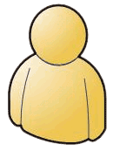
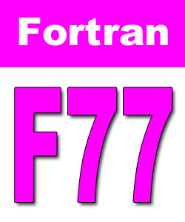


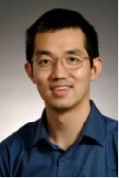
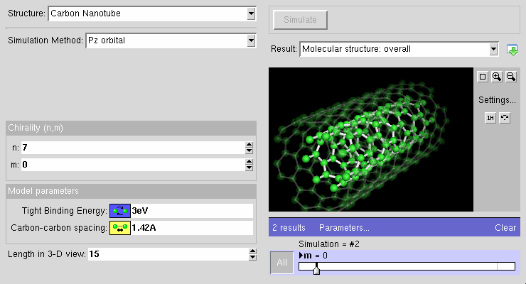
The HUBzero Platform
Perform
Research
Secure, Scalable,
Sharable
Dev Environments
Collaborate
With Others

Slide 3
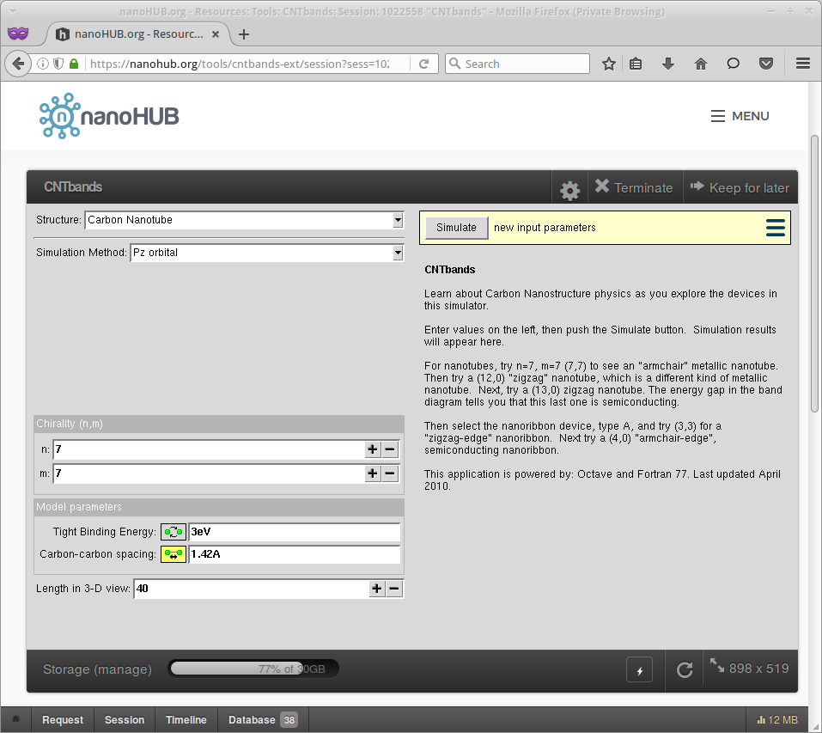
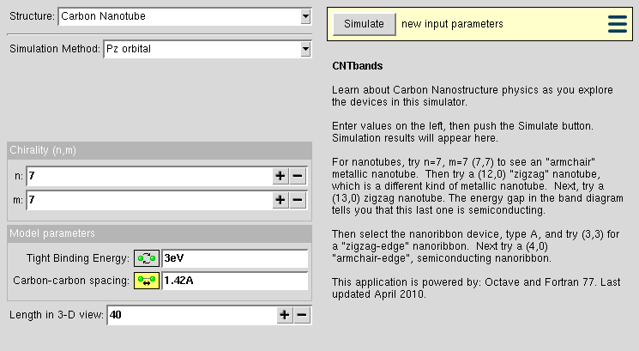
CNTbands
CNTbands
Science Domain: Nanoelectronics
Scientists: Lundstrom et al. (Purdue)
https://nanohub.org/resources/cntbands-ext

Slide 4
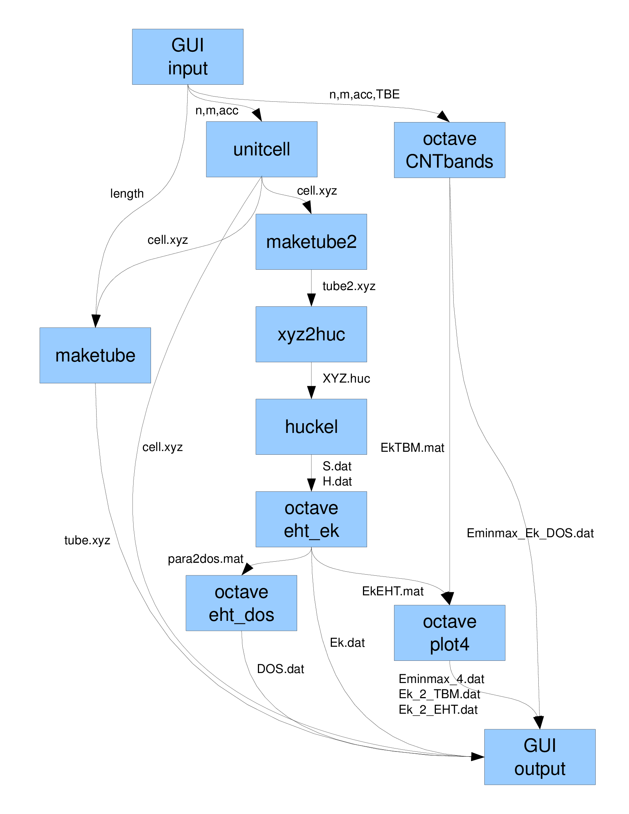
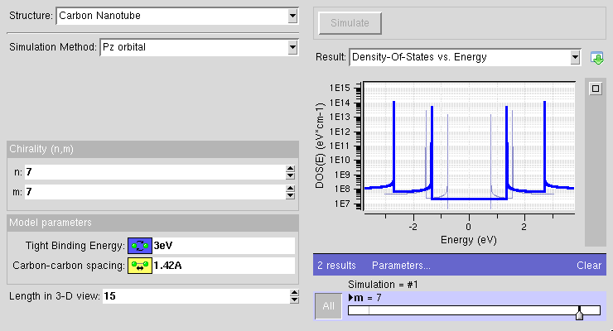
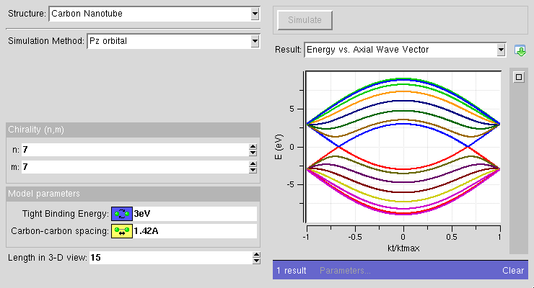
Many Pieces by Different Developers
CNTbands
Science Domain: Nanoelectronics
Scientists: Lundstrom et al. (Purdue)
https://nanohub.org/resources/cntbands-ext

Slide 5
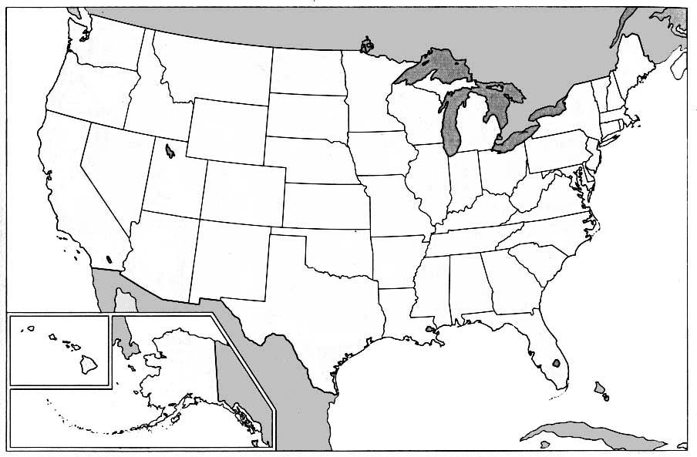
1990s – Initial Algorithms
M.P. Anantram
Researcher
NanoStructures

Slide 6
2002 – Idea for a Tool
Jing Guo
Researcher
Carbon Nanotubes
M.P. Anantram
NASA Scientist
NanoStructures

Slide 7
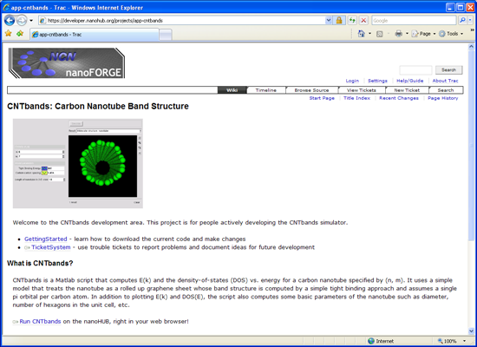
Tool Registered
https://yourhub.org/tools
Contribution form
Registered
Created
Uploaded
Installed
Updated
Provides:
Source code repository
Wiki for project documentaton
Placeholder for publishing tool
Access to HUB Workspace
Approved
Published
Retired

Slide 8



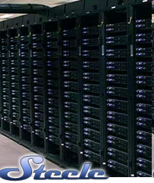

What is a Workspace?
Full-featured Desktop
Runs in the Cloud
For Developers & Researchers
Accessible from any web browser
Still running after you close browser
File storage provided by the HUB
local
clusters
File server
<number>

Slide 9
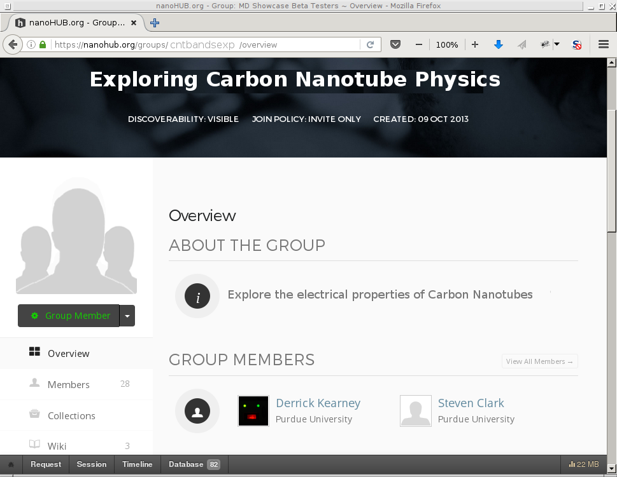
Collaborate within a Group
Build a community around your
research
Share links, papers, and data
Forums encourage discussion
Create how-tos with wiki pages
Keep everyone informed with
Announcements

Slide 10
CNTbands
CNTbands
Science Domain: Nanoelectronics
Scientists: Lundstrom et al. (Purdue)
https://nanohub.org/resources/cntbands-ext

Slide 11
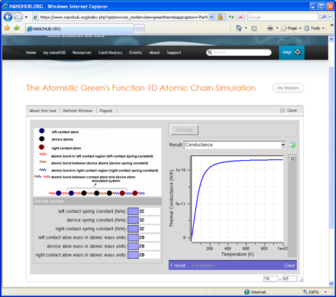
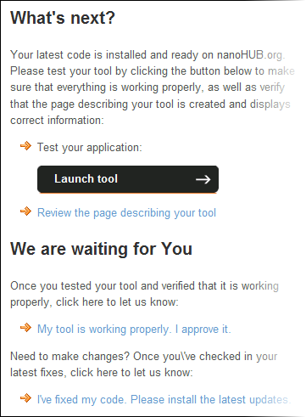
Installing Applications
Contribution form
Registered
Created
Uploaded
Installed
Updated
Approved
Published
Retired

Slide 12
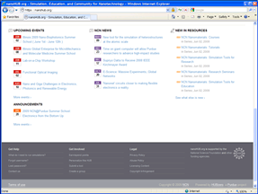
Publishing Applications
Contribution form
Registered
Created
Uploaded
Installed
Updated
Approved
Published
Retired

Slide 13
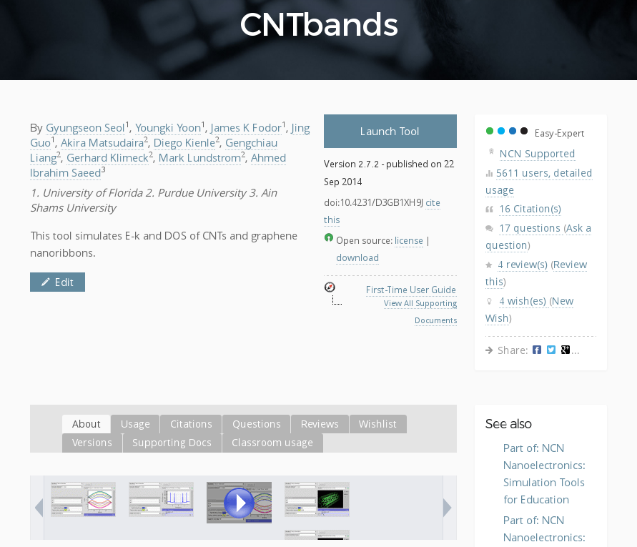
Knowing Your Impact

Slide 14
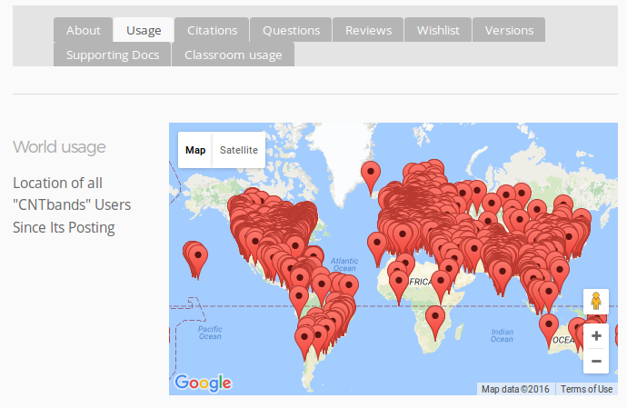
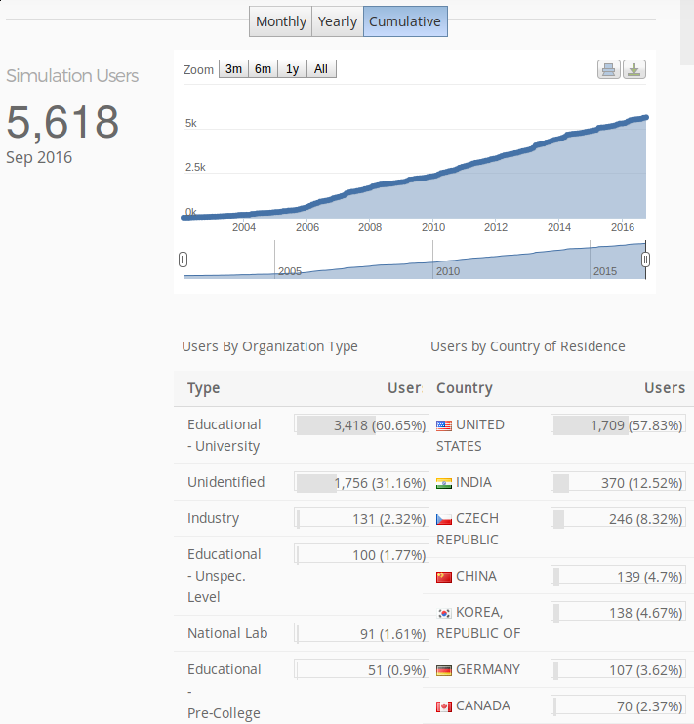
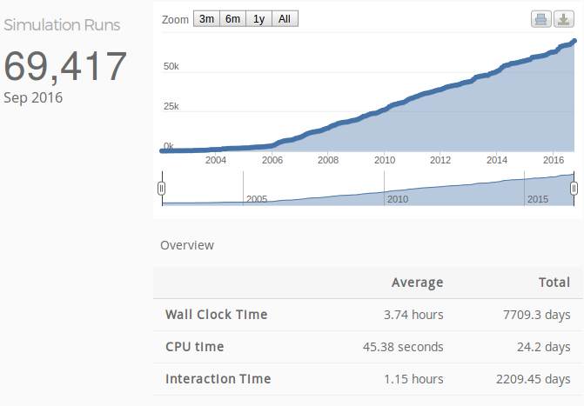
Track Usage Metrics

Slide 15
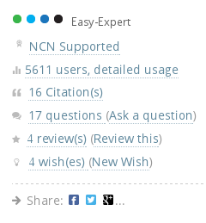
Communicate With Users

Slide 16
Adding New Features
CNTbands
Science Domain: Nanoelectronics
Scientists: Lundstrom et al. (Purdue)
https://nanohub.org/resources/cntbands-ext

Slide 17
2010 – Introducing New Researchers
New Grad Student
Graphene
NanoRibbons
M.P. Anantram
Professor
NanoStructures
Jing Guo
Professor
Carbon Nanotubes

Slide 18
Collaborate in the Workspace
New Grad Student
Graphene
NanoRibbons
M.P. Anantram
Professor
NanoStructures
Jing Guo
Professor
Carbon Nanotubes

Slide 19
Collaborate in the Workspace
New Grad Student
Graphene
NanoRibbons
M.P. Anantram
Professor
NanoStructures
Jing Guo
Professor
Carbon Nanotubes

Slide 20
Collaborate in the Workspace
New Grad Student
Graphene
NanoRibbons
M.P. Anantram
Professor
NanoStructures
Jing Guo
Professor
Carbon Nanotubes

Slide 21
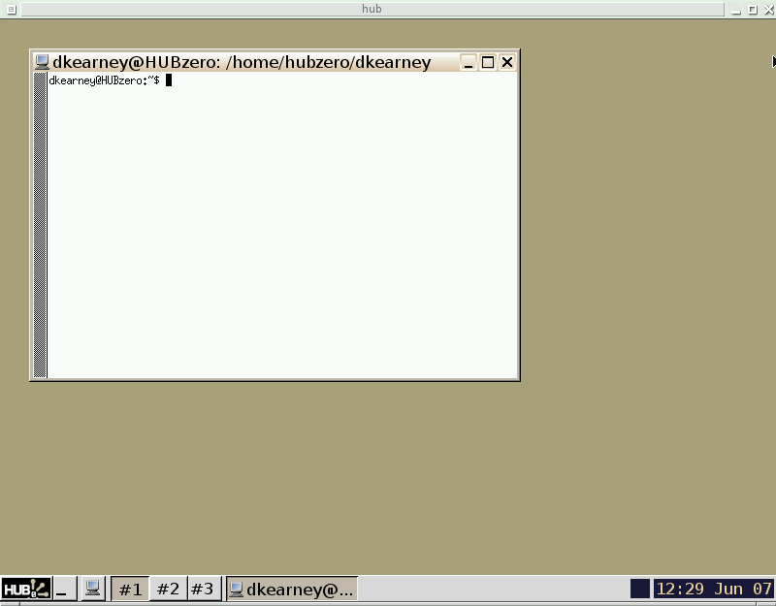
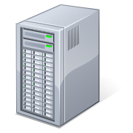
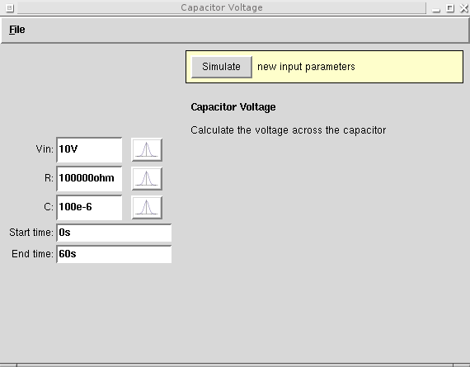

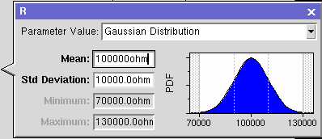
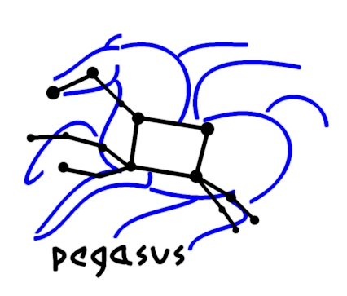
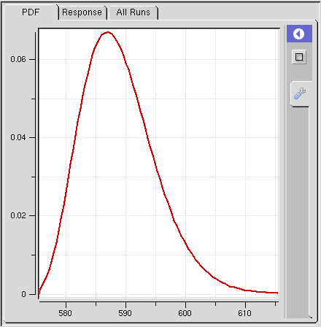
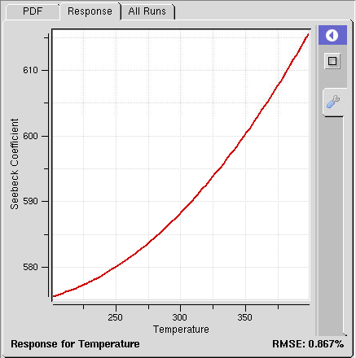
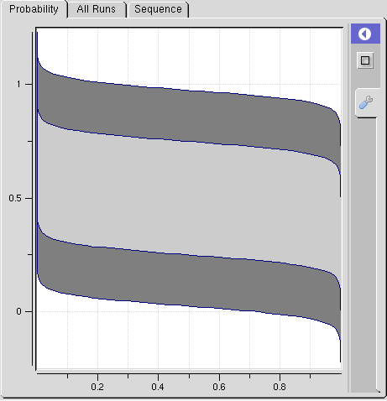
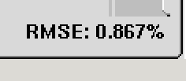
Productivity in the Workspace
Submit
Pegasus Workflows
Uncertainty Quantification
DAX
HUBzero Infrastructure
Tool Session
Containers
Submit
Proxy
Grid
Grid
Grid
Proxy
DAG
Grid
Grid
Grid
Grid
Notes:
While hubcheck library development has slowed over the last few months, there is still work to be done.
First, we need to continue to build more page objects to cover the web interface.
Need to put together a Debian package for easier installation of the software.
And we need to release the open source code in a hubzero repository connected to GitHub so others can use it.

Slide 22
Run tools locally in Workspace
User's Workspace Terminal
HUBzero Infrastructure
$ echo hi
hi
$
Tool Session
Containers
Submit
Proxy
Grid
Grid
Grid
Grid
Grid

Slide 23
Submit Jobs to Grid
User's Workspace Terminal
HUBzero Infrastructure
$ submit echo hi
Tool Session
Containers
Submit
Proxy
Grid
Grid
Grid
Grid
Grid
Grid

Slide 24
Let Submit create a workflow ...
User's Workspace Terminal
HUBzero Infrastructure
$ submit -p @@Vin=1-5 ./sim1.py --Vin @@Vin
scatter
Tool Session
Containers
Submit
Proxy
Vin=1
Vin=2
...
Vin=5
Grid
Grid
Grid
Grid
Grid
Grid
gather

Slide 25
… or write your own workflow
CNTBands
Science Domain: Nanoelectronics
Scientists: Lundstrom et al. (Purdue)
https://nanohub.org/resources/cntbands-ext

Slide 26
Productivity in the Workspace
Submit
Pegasus Workflows
Uncertainty Quantification
DAX
HUBzero Infrastructure
Tool Session
Containers
Submit
Proxy
Grid
Grid
Grid
Proxy
DAG
Grid
Grid
Grid
Grid
Notes:
While hubcheck library development has slowed over the last few months, there is still work to be done.
First, we need to continue to build more page objects to cover the web interface.
Need to put together a Debian package for easier installation of the software.
And we need to release the open source code in a hubzero repository connected to GitHub so others can use it.

Slide 27


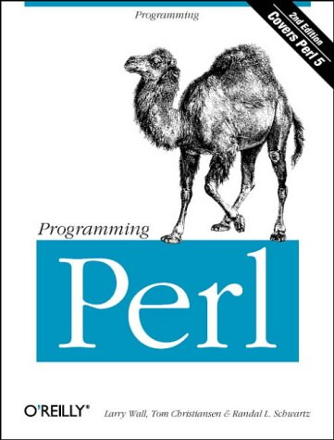
Pegasus Workflow Management
DAX
HUBzero Infrastructure
Developed at USC
Ewa Deelman et al.
Website: pegasus.isi.edu
Open Source
Bindings for your
favorite languages:
Tool Session
Containers
Submit
Proxy
Grid
Grid
Grid
DAG
Benefits:
Performance
Portability
Provenance
Data Management
Error Recovery
Grid
Grid

Slide 28
Productivity in the Workspace
Submit
Pegasus Workflows
Uncertainty Quantification
DAX
HUBzero Infrastructure
Tool Session
Containers
Submit
Proxy
Grid
Grid
Grid
Proxy
DAG
Grid
Grid
Grid
Grid
Notes:
While hubcheck library development has slowed over the last few months, there is still work to be done.
First, we need to continue to build more page objects to cover the web interface.
Need to put together a Debian package for easier installation of the software.
And we need to release the open source code in a hubzero repository connected to GitHub so others can use it.

Slide 29
Inputs and Outputs as Distributions

Slide 30

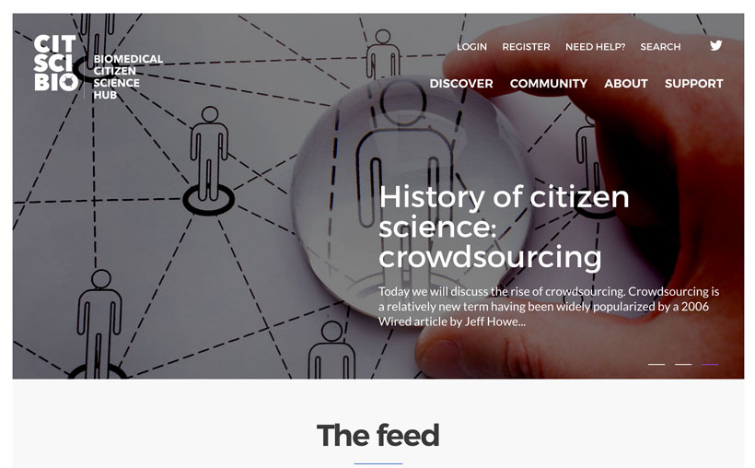
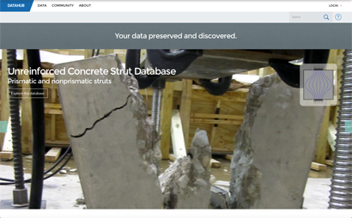
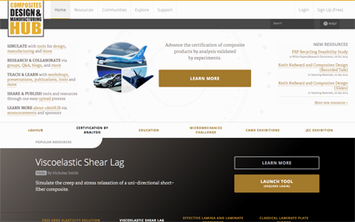


27 FTEs
18 Developers
5 Support/Training
10+ Years
Supporting Research
And Collaboration
2+M
Visits
HUBzero Infrastructure
Tool Session
Containers
Submit
Proxy
Grid
Grid
Grid
Secure, Scalable, Sharable
Dev Environments

Slide 31
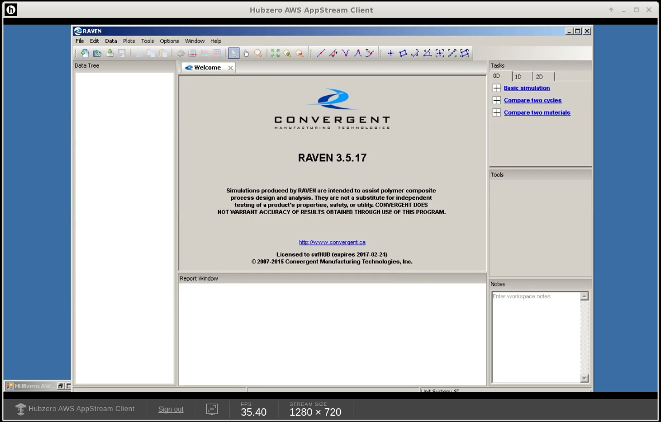
Windows tools and HUBzero
Newer feature to
complement our Linux
Tool functionality
Explore cloud based
resources
Initial implementation utilizes
AWS Appstream, a highly
optimized video intensive
Windows deployment platform
Overall effort focuses more on
end user application
deployment and collaboration
than tool development.
Use of commercial tools
Strict licensing requirements
Heavy single workstation requirements

Slide 32
“Macro” level workflow
Pegasus is one of many granular scientific workflow management tools
Highly automated workflows
Specializes in task partition and scheduling in HPC environments
We're also working on higher level workflow – Business Rules Engine
Focuses more on higher level tasks
Higher degree of user interaction
Use a mix of workflows at several different levels
Use of heterogeneous operating systems

